Slide 1
The relation between R and the FCC cell side is shown in the Figure 13 is √2𝑎 =4𝑅 and the APF is given by equation 3
With regard to BCC crystal effective number of atoms per unit cell is 8 × (1/8) + 1 = 2 and the relation between R and a is given by √3𝑎 =4𝑅 and the APF is given by equation 4. While, the relation between R and the BCC cell side is shown in the Figure 14

Slide 2
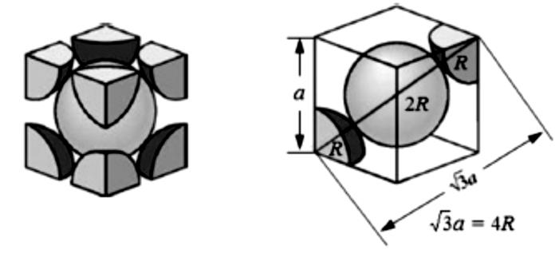
Figure 14 Schematic of the BCC cell shows R and a variables

Slide 3
Finally, In the hexagonal unit cell, number of atoms = 12 corner atoms × 1/6 (shared by six unit cells) + Two face atoms × ½ + 3 interior = 6.
The relation between R and a is given by 2R = a .
Unit cell volume = (6 × ½ × a × h) × c = (3 × a × a sin60 o) × c = 3a2 c sin60o
The face-cantered atom and the three mid-layer atoms form a tetrahedron MNOP which has sides equal to a (as atoms at vertices touch each other) and height of c/2. Using this tetrahedron it can be shown that for an ideal hexagonal crystal c/a ratio = 1.633

Slide 5
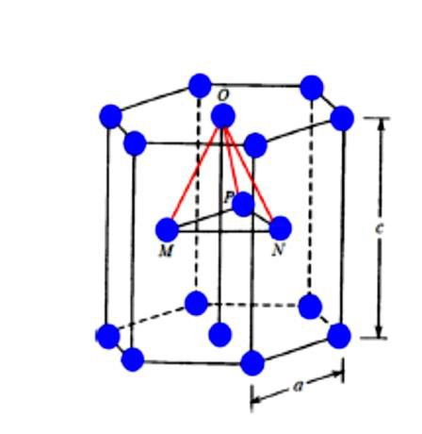
Hexagonal lattice and atomic packing factor variables are shown in Figure 15
Figure 15 Hexagonal lattice

Slide 6
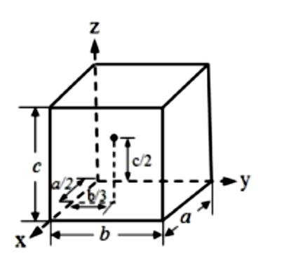
3.2 Crystal Planes and Miller Indices
• Point Coordinates
Position of any point in a unit cell is given by its coordinates or distances from the x, y and z axes in terms of the lattice vectors a, b and c. Thus the point located at a/2 along x axis, b/3 along y axis and c/2 along z axis, as shown in the figure below, has the coordinates 1/2 1/3 1/2 .

Slide 7
• Crystal Planes
Planes in a crystal are described by notations called Miller indices
✓ Miller indices of a plane, indicated by h k l, are given by the reciprocal of the intercepts of the plane on the three axes.
✓ The plane, which intersects X axis at 1 (one lattice parameter) and is parallel to Y and Z axes, has Miller indices h = 1/1 = 1, k = 1/∞ = 0, l = 1/∞ = 0. It is written as
(hkl) = (100).
✓ Miller indices of some other planes in the cubic system are shown in the figures in the next slide

Slide 8
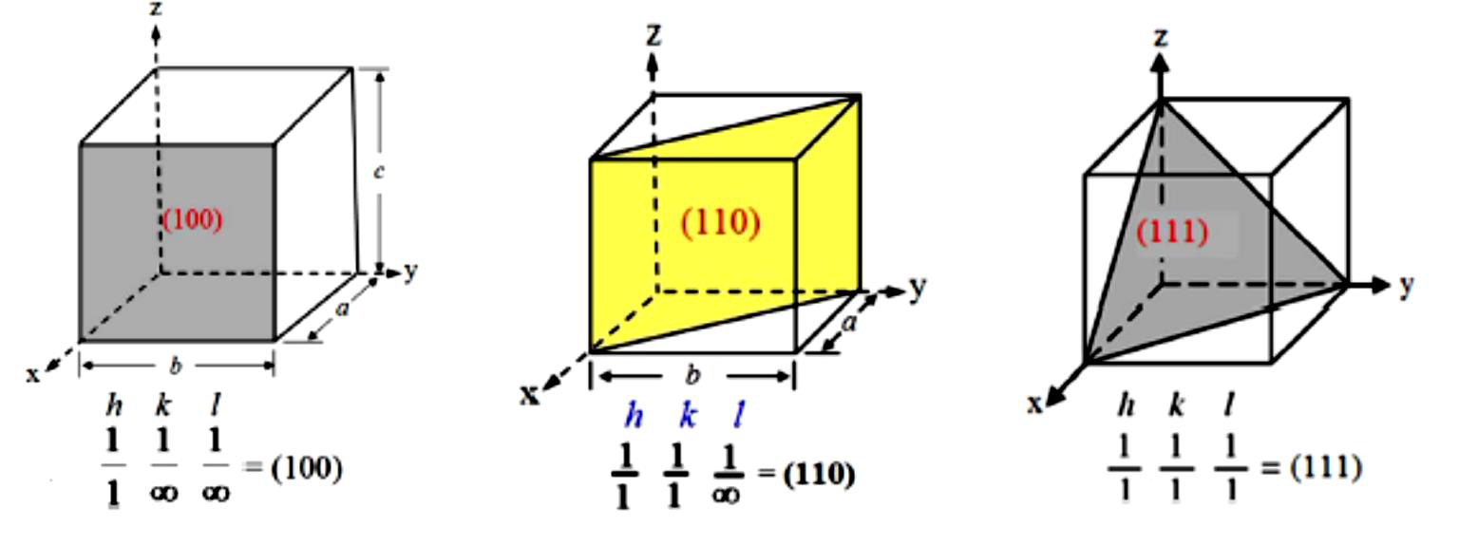
Figure )16( Examples of some crystal planes

